Slide 1

KIT851 – PROJECT-II
Rajkiya Engineering College, Bijnor
Department of Information Technology
Project on
AI BASED ART CREATOR USING NLP
Under supervision of
Presented By:
Aditya Kumar (1907350130009)
Akash Chaurasia (1907350130010)
Navneet Sagar (1907350130042)
Shagun Singh (1907350130056)
Mr. Vivek Kumar Jaiswal
(Assistant Professor)

Slide 2
Content
Introduction
Problem Statement
Methodology
Mechanism
Results and Outputs
Future Work
Conclusion
References

Slide 3
Introduction
The generation of images from the regular language to some fictional or imaginary scenario by meeting the condition of that whole text.
Generating a picture that represents a scene or object described in the text, or creating an image that includes text as part of the image itself.
This will create fictional-realistic image or scenario that does might not exist.

Slide 4
Problem Statement
As it is difficult to understand the text by reading it and visualizing can become an issue. Every person is self creative but they are unable to see the execution of their thought even in visualization.

Slide 5
Methodology
CLIP Model
Stable Diffusion model
Gradio

Slide 6
CLIP Model
CLIP- Contrastive Language-Image Pre-training.
Model that takes image-caption pairs and creates “mental” representations in the form of vectors, called text/image embeddings.
The process of encoding the features of a sentence and an image is what CLIP does.

Slide 7
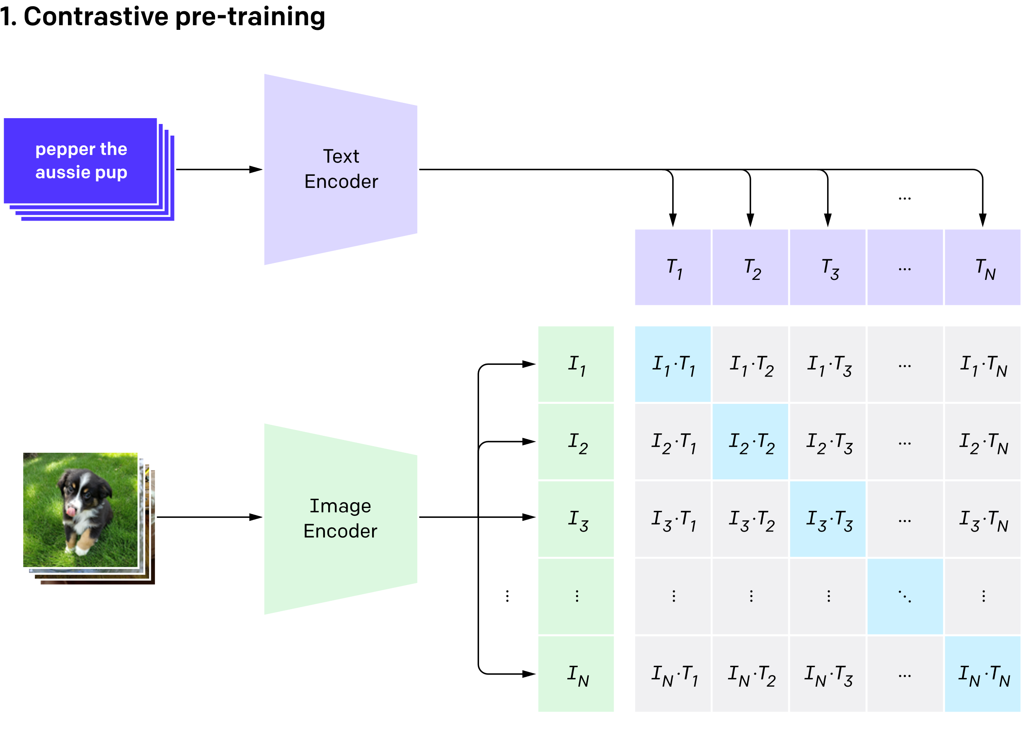
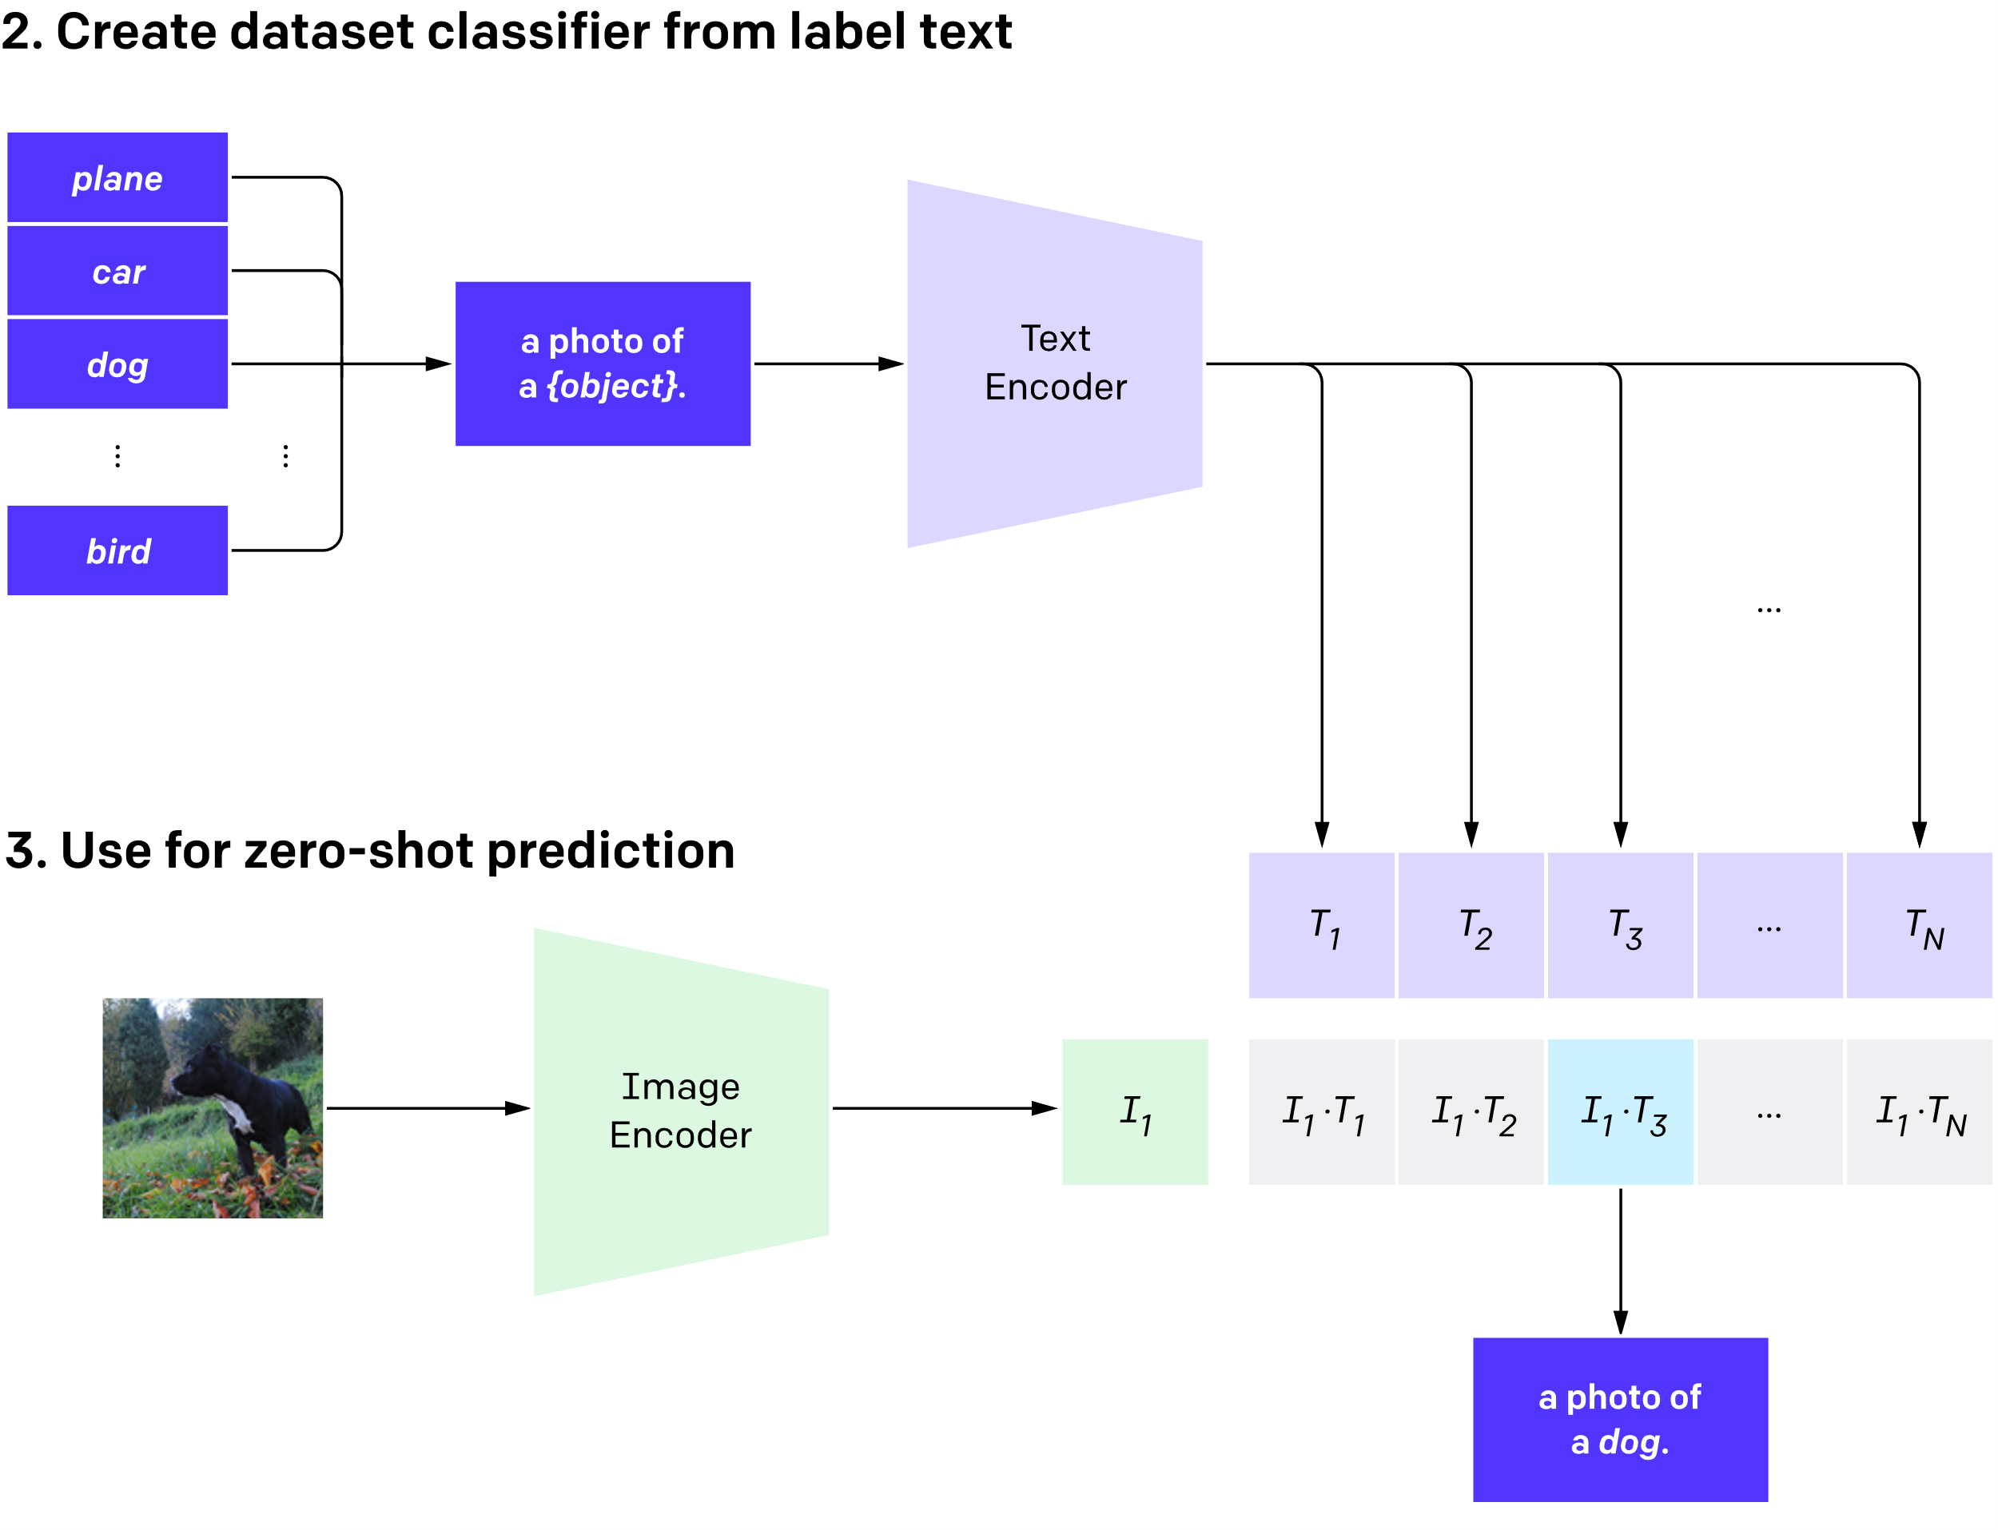
Clip model working
Fig. 1.1.1- Pretraining of text encoder and Image Encoder
Fig. 1.1.2- Encode the images and text snippets

Slide 8
Stable Diffusion model
Basically for text-to-image generation.
It decompose images in many small “denoising” steps.
It focuses on stability and convergence speed.
Diffusion Models learn to generate data by reversing a gradual noising process.
Diffusion Models are generative models.

Slide 9
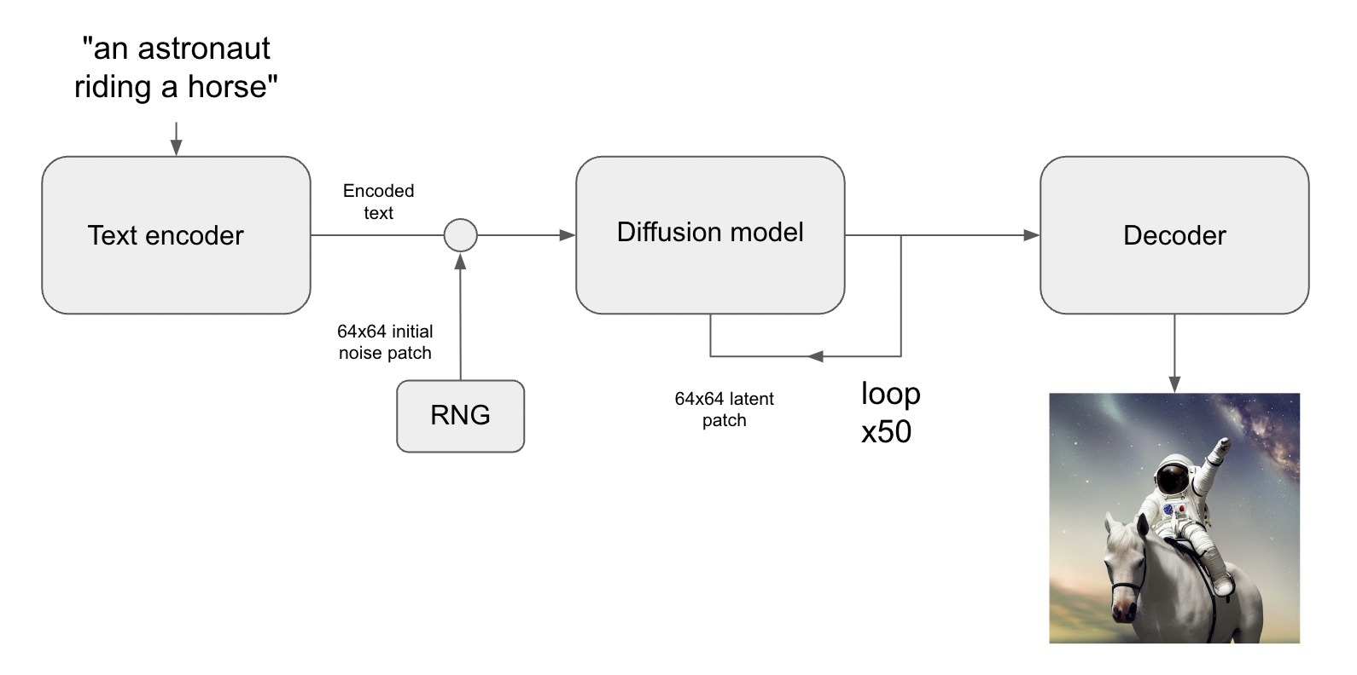
Stable Diffusion Model Architecture
Fig 1.2.2 : Working architecture of model.

Slide 10
Working of backward and forward diffusion
Backward Diffusion
(Denoising)
Forward Diffusion
(Noising)
Fig 1.2.1 : Forward & Backward Diffusion

Slide 11
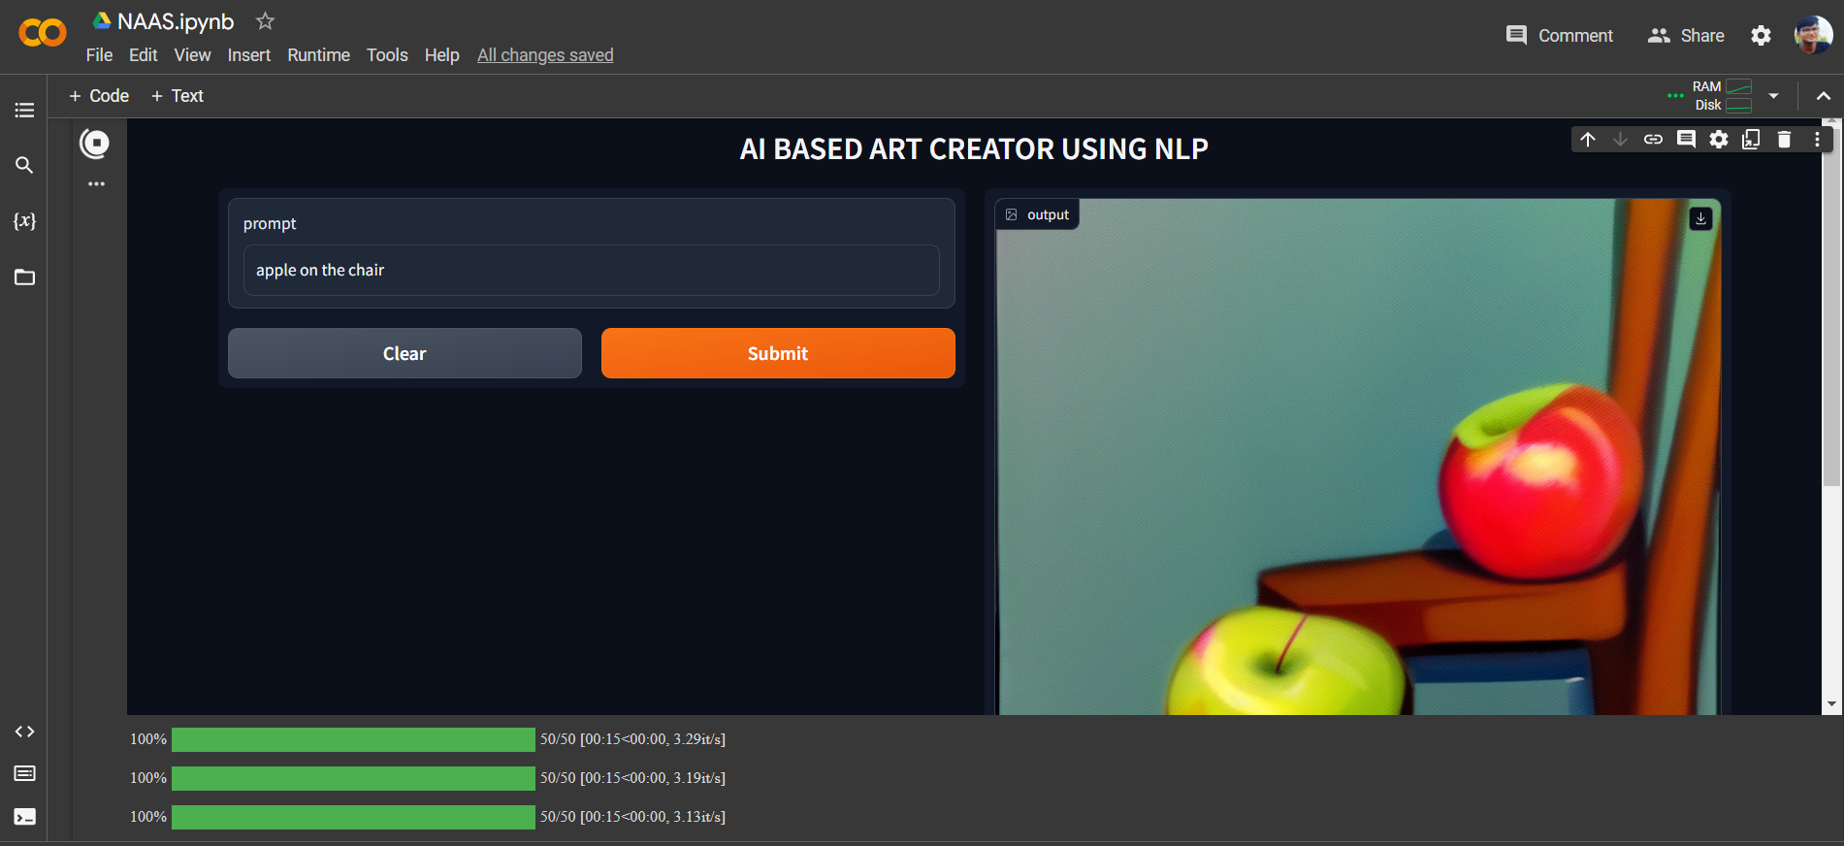
Gradio
Gradio Live is for creating and sharing interactive web demos of ML models quickly.
It enables you to transform any Python function into a web interface, accessible by anyone from anywhere.
Customization options are available for input and output components
Fig 1.3 : Sample Gradio interface.

Slide 12
Mechanism
This process of encoding the features of a sentence and an image is what CLIP does.
The U-Net in stable diffusion takes encoded text (plain text processed into a format it can understand) and a noisy array of numbers as inputs.
Steps Consist of-
Diffusion
Encoder
Diffusion steps
Stability and Convergence
Text to image generation

Slide 13
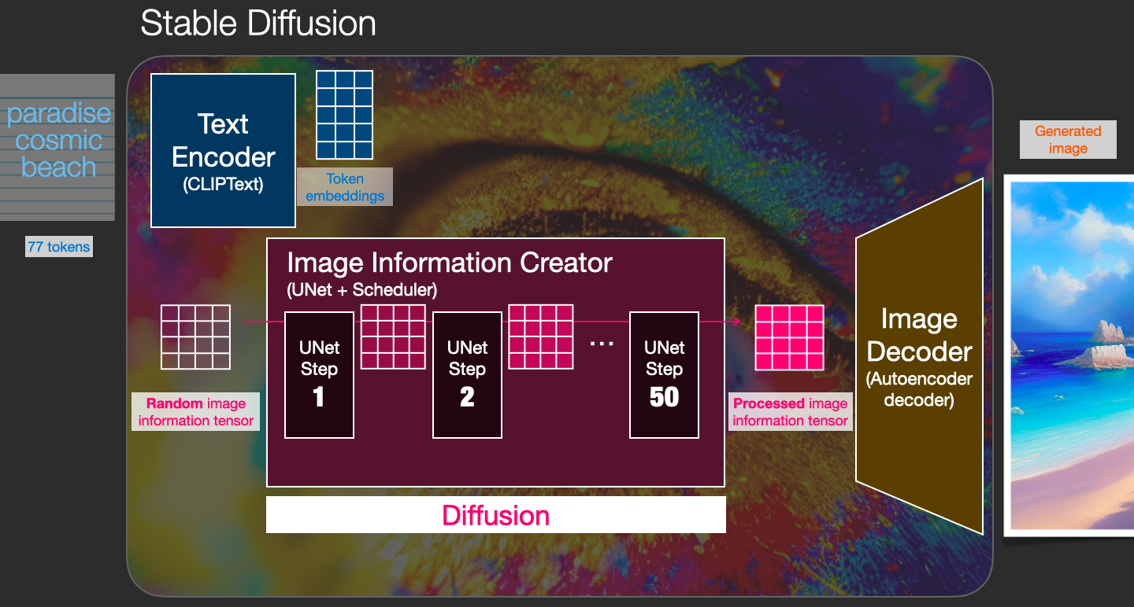
Mechanism
Fig 2 : Mechanism of Stable Diffusion with Clip and Unet + Scheduler

Slide 14
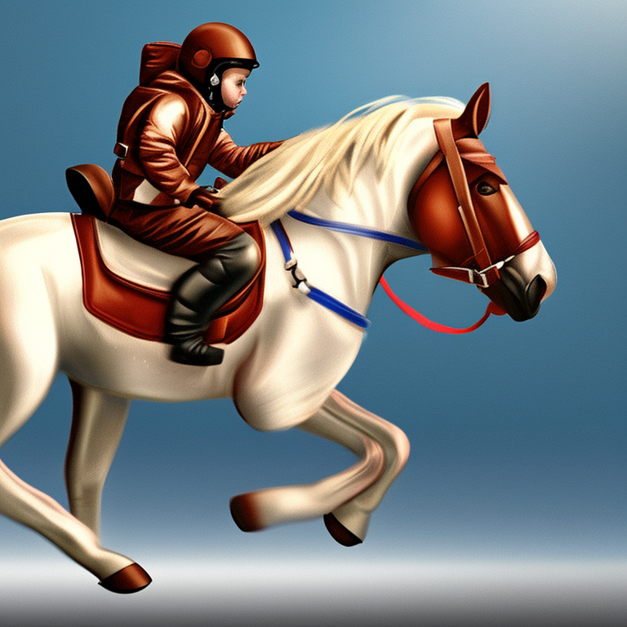
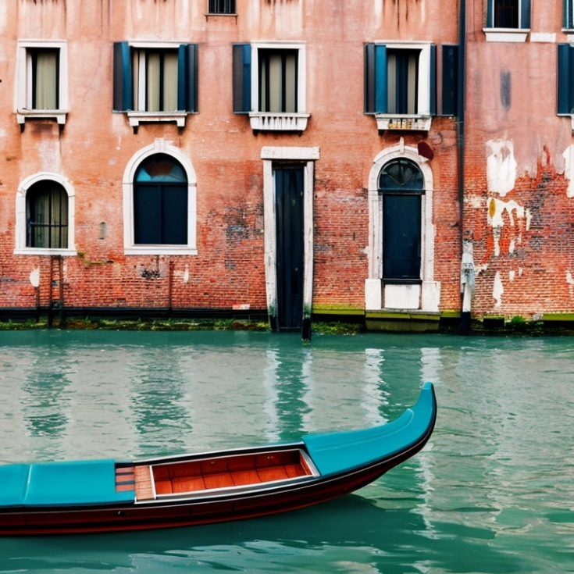
Results and Outputs
Fig 3.1: An astronout riding horse in photorealistic view
Fig 3.2: A boat in the canals of venice

Slide 15
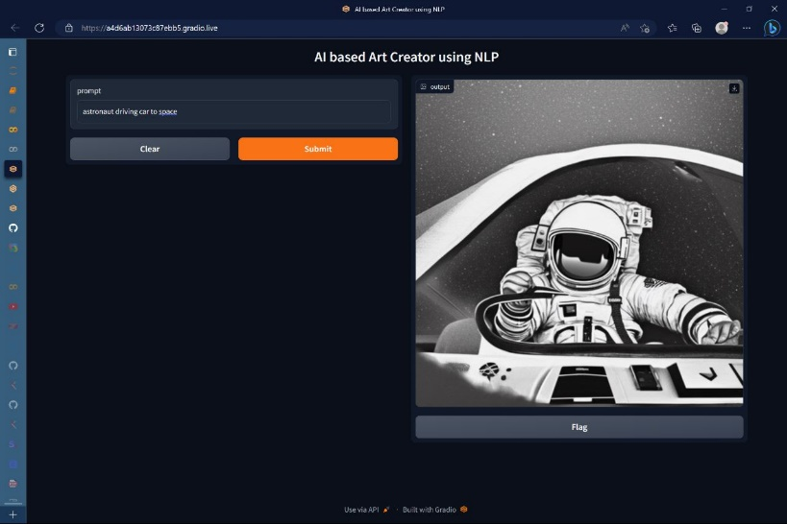
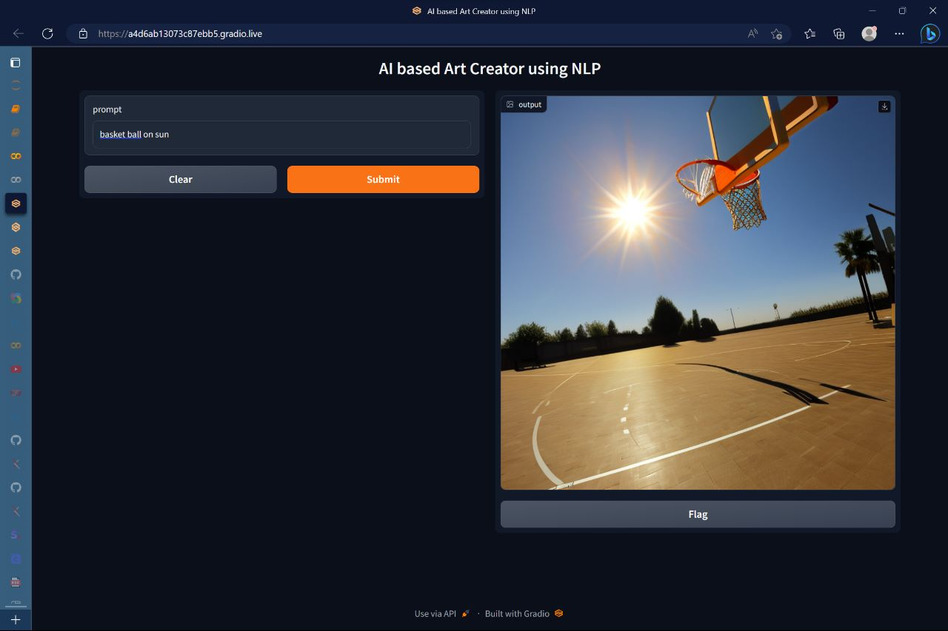
Results and Outputs
Fig 3.3: An astronaut driving a car
Fig 3.4: Basketball on Sun

Slide 16
Future Work
Generating more realistic images.
Text prompt spell check.
Creating platform for end user.

Slide 17
Conclusion
After conducting a combined study of the papers and planning the project implementation, we developed an easy and efficient model for image generation.
Our hope is that this project will empower people to express themselves creatively.
This project also helps us understand how advanced AI system see and understand our world.
Helps in understanding the some textual concepts in the form of visualization

Slide 18
References
Ramesh A., Pavlov M., Goh G., Gray S., Voss C., Radford A., Chen M., and Sutskever I.: Zero-Shot Text-to-Image Generation. In: Meila, M., and Zhang, T. (eds.) Proceedings of the 38th International Conference on Machine Learning. Proceedings of Machine Learning Research, pp. 8821–8831. PMLR (2021)
Alec Radford, Jong Wook Kim, Chris Hallacy, AdityaRamesh, Gabriel Goh, Sandhini Agarwal, Girish Sastry,Amanda Askell, Pamela Mishkin, Jack Clark, et al. Learning transferable visual models from natural language supervision. arXiv preprint arXiv:2103.00020, 2021.
Prof. Sainath Patil,Akanksha Singh, Sonam Anekar, Ritika Shenoy : Text to Image using Deep Learning. ISSN: 2278-0181, published on International Journal of Engineering Research & Technology (IJERT)
R. Rombach, A. Blattmann, D. Lorenz, P. Esser, and B. Ommer, “High-resolution image synthesis with Latent Diffusion Models,” arXiv.org, 13-Apr-2022. [Online]. Available:
Alammar, “The Illustrated Stable Diffusion,” The Illustrated Stable Diffusion — Jay Alammar — Visualizing machine learning one concept at a time. [Online]. Available:
A. Gordić, “Stable diffusion: High-resolution image synthesis with latent diffusion models | ML coding series,” YouTube, 01-Sep-2022. [Online]. Available:

Slide 19


